Slide 2
X.509 Authentication Service
X.509 defines a framework for the provision of authentication service by theX.500 directory to users
X.509 is based on the use of public key cryptography and digital signature
The heart of X.509 scheme is the public key certificate associated with each user
The general format of certificate is shown below
These certificates are created by same trusted certification authority(CA) and placed in the directory by the CA or by the user

Slide 3
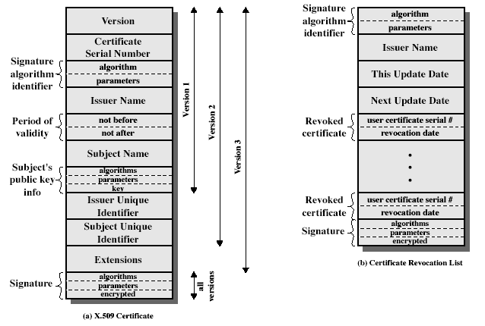

Slide 4
Version: Differentiate amg successive versions. Default is version1.If issues unique identifier and subject unique identifier are present the it must be version2.If one or more extensions are present, then it must be version 3
Serial no: It is an integer value and is unique
Signature Algm Identifier-The algm used to sign the certificate together with its associated parameters
Issue name-X.500 name of the CA that created and signed this certificate
Period of validity-Consist of 2 dates. First and last on which certificate is valid
Subject name:The name of the user to whom the certificate refers

Slide 5
Subjects Public key information: The public key of the subject + identifier of the algm + associated parameters

